Slide 1
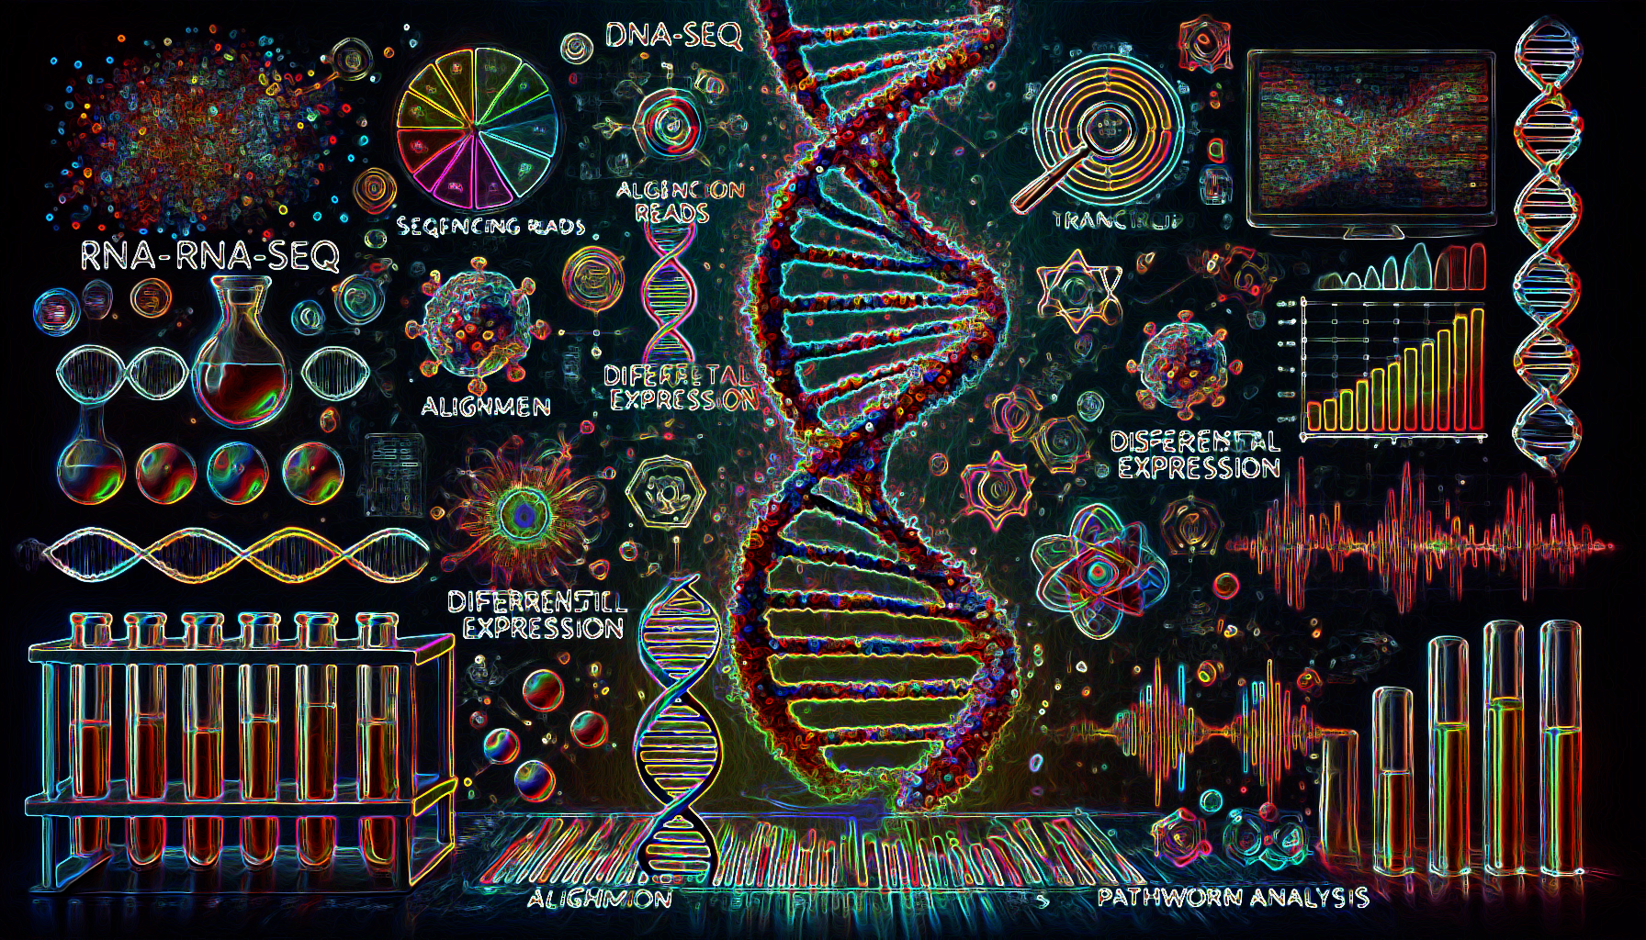
Module #5: RNA-Seq Analysis: From Raw Data to Biological Insights
Muhammad Elsadany
Department of Psychiatry
Michaelson Lab

Slide 2
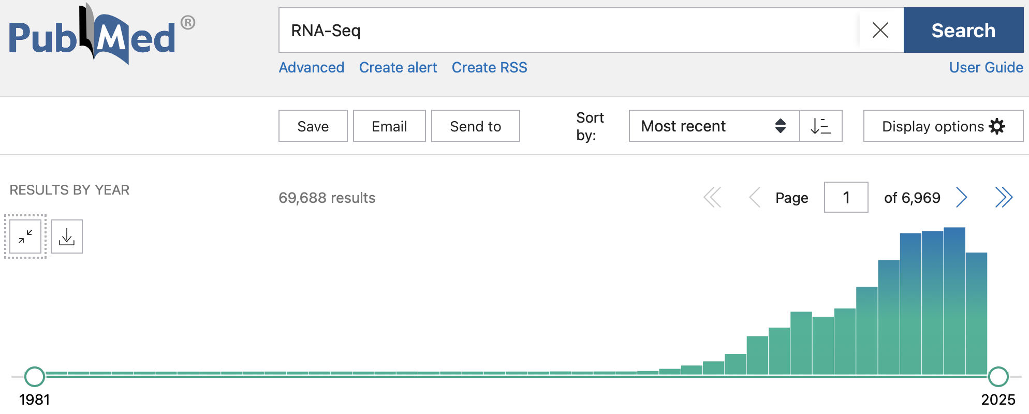
RNA-Seq
Captures the snapshot of RNA presence and quantity from a biological sample at a given moment.
Identifies differentially expressed genes (DEGs) under various conditions (e.g., healthy vs. diseased tissue)

Slide 3
RNA-Seq Workflow Overview
Experimental Design Replicates, sequencing depth
Sequencing Platforms (Illumina, PacBio, Oxford Nanopore)
Quality Control Raw data checks (FASTQ files)
Read Alignment/Mapping Mapping reads to reference genome
Quantification Counting reads per transcript/gene
Differential Expression Analysis Compare expression levels between conditions
Functional Enrichment Pathway analysis, gene ontology

Slide 4
RNA-Seq Workflow Overview
Experimental Design Replicates, sequencing depth
Sequencing Platforms (Illumina, PacBio, Oxford Nanopore)
Quality Control Raw data checks (FASTQ files)
Read Alignment/Mapping Mapping reads to reference genome
Quantification Counting reads per transcript/gene
Differential Expression Analysis Compare expression levels between conditions
Functional Enrichment Pathway analysis, gene ontology

Slide 5
RNA-Seq Workflow Overview
Experimental Design Replicates, sequencing depth
Sequencing Platforms (Illumina, PacBio, Oxford Nanopore)
Quality Control Raw data checks (FASTQ files)
Read Alignment/Mapping Mapping reads to reference genome
Quantification Counting reads per transcript/gene
Differential Expression Analysis Compare expression levels between conditions
Functional Enrichment Pathway analysis, gene ontology

Slide 6
Quality of reads (incorrect nucleotide calls)
How to fix?
Length of reads (presence of adapters)
How to fix?
Quality Control

Slide 7
Where did that read come from?
Solving a puzzle
 | Alignment

Slide 8
Quantify the number of reads per gene, or more specifically the number of reads mapping to the exons of each gene.
Why exons?
 |  | Quantification

Slide 9
Compare the expression of single genes between different conditions and identify differentially expressed genes (DEGs).
An independent test per gene
What’s a p-value? FDR (adjusted p-value)?
 |  |  | Differential Expression

Slide 10
Find out if the DEGs are enriched transcripts of genes which belong to more common or specific categories to identify biological functions that might be impacted.
What if you get a list of DEGs, but couldn’t find any enrichment of pathways?
 |  |  |  | Functional Enrichment

Slide 11
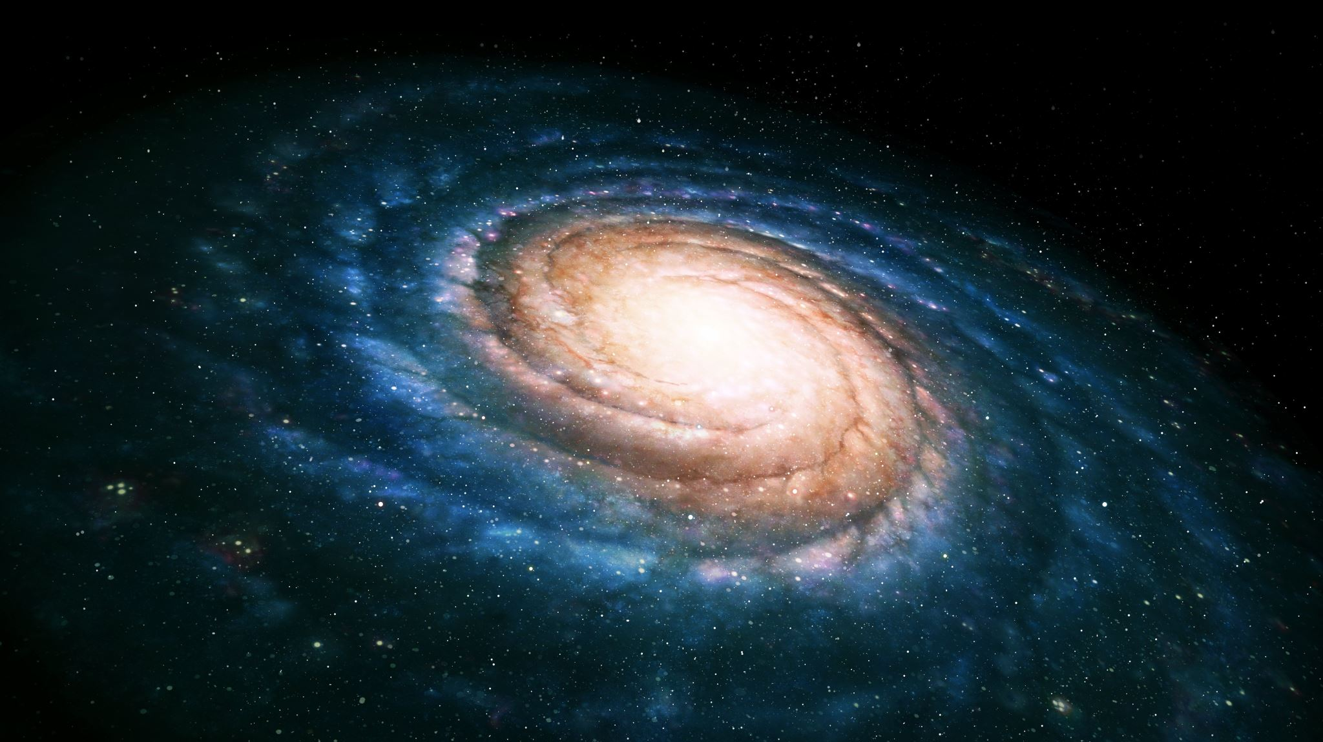
Workshop on Galaxy

Slide 12
Additional Tools and Websites
RNAseqChef:
https://www.jbc.org/article/S0021-9258(23)01838-0/fulltext#app-1
https://imeg-ku.shinyapps.io/RNAseqChef/
RaNA-Seq:
https://ranaseq.eu/analysis

Slide 13
Quality Control | Alignment | Quantification | Differential Expression | Functional Enrichment

Slide 14
Raw FASTQ
Trimmomatic

Slide 15
Go to GEO, search for GSE179379
In that page, find the SRA accession number and copy it
Go to the SRA website and paste the accession number in the search box.
Select all 20 samples you see in the results
Click on “Send results to Run selector” hyperlink at the top.
You should see 20 files with a 12.55 Gb size
Select all 20 Runs and click on Galaxy in the computing column of the second table in that page.
You should be on galaxy server now

Slide 16
Wait until the SRA files are done being transferred to the server

